Slide 1
Problem Management Module: An Innovative System to Improve Problem List Workflow
Chad Hodge, MS
Software Architect, Intermountain Healthcare
PhD Student, University of Utah
AMIA 2014

Slide 2
Authors
Chad Hodge, MS
Kathryn Kuttler, PhD
Scott Narus, PhD
Len Bowes, MD

Slide 3
Background
Problem lists are important…
Better care
Improves clinician workflow
Downstream activities
Cohort generation
… If used effectively
Mostly inaccurate, incomplete, and out of date
Duplicate entered problems / Multiple problem lists
Lots of free-text and org specific concepts that are not sharable
Notes:
I am sure that most everyone here knows a problem list is simply a listing of a patients health issues, such as diagnoses, symptoms, and medical history.
But did you know that if a patient’s clinician keep an up to date and accurate problem list, that patient
generally receives better care?
has less frequent omissions of care
And benefits from evidence based care more frequently?
However, for all the good that they can do, problem lists are not used effectively.
They are mostly inaccurate, incomplete, or out of date. In fact, in one study, it was found that for conditions as important as coronary artery disease and hypertension, only 50% of the patients with these diagnoses had any mention of it on their problem list.
Problem lists are also plagued by a lack of ownership. There is disagreement about who owns a problem once it is added to a patients list. This confusion leads to no one wanting to update a problem they did not personally add, which inevitably leads to duplicate problems added to this, which clutters it, making it less usable.
When that rare clinician does actually use the problem list, the concepts they are looking for may not exist, or are hard to find. This requires them to add the problem as free-text. These types of concepts do not trigger decision support for evidence based guidelines, nor are they readily computable for aggregating into population reports, or for research.
Add to this the fact that some organizations actually keep multiple problem lists for a single patient, and it is easy to understand why so many clinicians don’t even bother with the problem list at all.

Slide 4
Objective
Move from a problem list to a problem management system
Address reasons for under-utilization
Reduce the number of out-of-date problems
Reduce free-text problems
Improve workflow
Reduce missing attributes
Reduce Tension between care teams
Notes:
At IHC, we are not immune to these issues. In fact, when we began this work:
only 47% of patients had ANYTHING on their problem list at all.
Of that 47%, the median number of problems on a list was just 1, and of those, 28% were free-text.
In fact, as a whole, a mere 34% of IHC patients met the Meaningful Use requirements of an active coded problem.
With that in mind, our goal was to try to address as many of the root causes as possible, moving us from a problem list, to a more comprehensive problem management system.
Specifically, we focused on :
reasons for under-utilization
reducing the number of out of date problems
reducing the number of free-text problem added to the lists
Making it quicker to add new problems to the list
Reduce the number of missing attributes per problem added to the list
And to reduce the tension that existed between care teams that managed a patients problem list

Slide 5
Setting
Software in use for nearly 2 years
7 IHC NICUs
1 adult STICU
Hospitalists on acute care floors
Tele-Health clinicians
Used by 580 total clinicians in 9 distinct locations
Both the new system and the legacy system were operational at the same time.
Data from each application was stored in separate tables in the EDW
Methods section? New HI model?
Notes:
To achieve these objectives, we built a completely new problem list application in small increments, over the course of 3 years.
During these 3 years, we met with dozens of clinicians to understand the issues with the current system, to guide us on our intended solutions, and to test and validate the work we produced.
This software has been in place for nearly two years at all 7 IHC NICUs, 1 adult STICU, and made available to all hospitalists, and to Tele-Health clinicians.
These groups have historically been big users of the problem list, and were best able to provide meaningful feedback on our initial work.
During the time of this study, we 580 clinicians from 9 units using this system. Not just MDs, but also NPs and PAs.
While we were piloting this system, both the new intervention, and the legacy application were running in parallel. We stored the data from each application in separate tables for easier processing and analyses. However, users of either system saw a merged lists of problems from both systems, so that no critical issue was missed by either care team.

Slide 6
Master Problem List
Notes:
So lets get to the new stuff.
This is an image of the master problem list, which was the main landing screen of our new application.
Each patient has a single problem list, which we called the Master Problem List.
This list is longitudinal, and encapsulates every problem a patient may have from birth until death, whether it be active, inactive, acute, chronic, or historical.
Since this list could get rather large, especially for critical care patients or the elderly, we provided a few tools to reduce the content, so clinicians did not get overwhelmed.
Specifically, we automatically rolled up duplicate problems, and added a superscript to indicate count, as we did here with Pneumonia.
We also provided multiple sort capability, filtering, and custom sort order that persisted across sessions, allowing clinicians to see their preferred problems at the top of the list.
Other things to note here is the status icon, and the relative onset date which improved clinician workflow by reducing the complexity of the list items.
If a clinician wants to add a new problem, or quickly determine if a patient already has a specific problem, he just clicks in the search box on top of the screen, and begins typing.

Slide 7
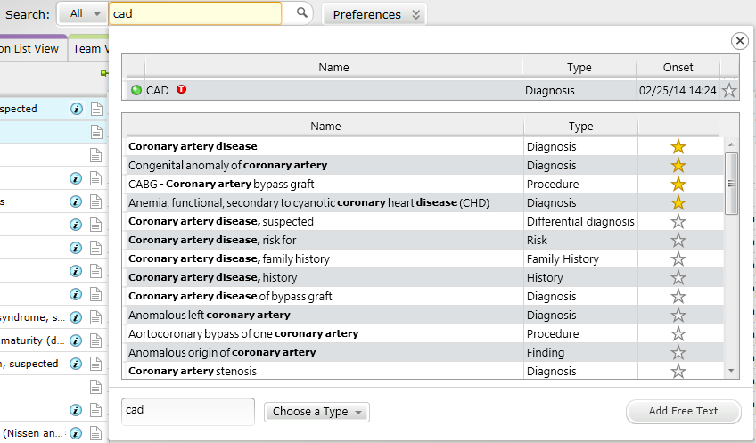
Smart Search
Notes:
Scrolling through a long list of search results can be tedious, and often led to
duplicate entry because clinicians cant find the previous instances they were looking for.
Or free-text entry, because the concept they wanted was immediately visible.
To solve this problem, and to improve the way problems were added to the problem list, we created the Smart Search tool.
Our smart search tool simultaneously searched and merged results from 3 different databases:
Patients master problem list.
Terminology database
Clinicians common list
The patients master problem list is shown first. It shows any matches against currently active or historical problems the patient has had. This reduced the number of times duplicate problems were entered on a problem list by showing the clinician it was there before it was added again.
The terminology search is against a constrained CURATED domain, so results were meaningful to the clinicians using the system. Additionally, the entered search term was automatically expanded to include synonyms and acronyms, like is shown in CAD above.
The third source searched is the clinicians personal common list. This is a catalog of commonly used problems for each clinician, like a list of favorites. These results are sorted to the top of the result set, so they can be quickly added to the problem list, shown by the Gold stars in the image.
Simply clicking any of these search result items will automatically add a new instance of the problem to the patients master problem list.
Most of these terms have been pre-coordinated, and already know the type of problem, body system affected, and default status.
This reduces the number of missing elements per problem.
If the clinician does not see the term he is looking for, he can always add the problem as a free-text problem, shown at the bottom of the image.

Slide 8
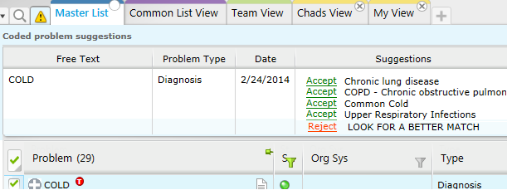
Feedback Mechanism
Notes:
If a clinician does add a free-text problem, an automated workflow is initiated that attempts to replace the term with a coded concept.
The problem is added as free-text instantly, but behind the scenes, an asynchronous request is sent to the terminology work queue. When the terminology team is able to address the request, they look in the curated domain for synonyms or acronyms, or add new concepts as needed. They then provide a few choices back to the clinician that can be accept as a substitute for the free-text problem he previously entered. Accepting one of these terms will automatically change the free-text term into the coded term. This increases the number of coded concepts on the problem list, enabling CDS, infobuttons, and MU.
If rejected, the clinician must provide a reason. The terminologist then attempts to find a match one more time. If the clinician does not accept a match this time, it is simply left as free-text.
This work not only benefits the single clinician, but also quickly makes new concepts / synonyms / acronyms available for all other clinicians to use.
If you are interested in this process, I have a poster here at AMIA that goes into more details, so stop by.

Slide 9
Problem Evolution
Finding | Risk
Procedure | Event
Differential Diagnosis | Family History
Diagnosis | History Of
Health Maintenance | Social History
Notes:
Problems tend to follow a predictable progression, or evolution. When treating a patient, clinicians begin creating a mental list of differential diagnoses, ruling out or confirming each one as data become available. Once confirmed, a differential diagnosis is evolved to a diagnosis, meriting treatment and monitoring. When a diagnosis is resolved, if a clinician decides that a reminder of the condition should be available to other caregivers, the diagnosis is evolved to a historical problem.
To support this process, and improve clinician workflow, we created the problem evolution feature. Working with a team of interdisciplinary clinicians, we identified a list of 10 distinct types of problems we wanted our application to track, shown in the table above.
The example above shows a typical evolution of Sepsis from DDX to DX to Historical problem. Notice that this creates 3 completely separate problems which are semantically linked, so that the clinician will only ever see the most current concept in the chain.
For evolution to occur automatically, we created a knowledge document for each of the 8,000 curated problems. Each document listed the concept codes for the problem in its DDX, DX, and historical phases, as well as what statuses for each problem should trigger the evolution. This allows the clinician to simply change the status of a problem, and an entire workflow is triggered behind the scenes which results in a new problem being added to the list in place of the old one, without the clinician having the think about it.

Slide 10
New Problem Indicator
Notes:
When a clinician sees a patient and updates the problem list, there is a sense of ownership over what is in the problem list. However, when the same patient is seen later, the list may be significantly different because other clinicians have seen the patient and added or updated problems. When this occurs, the sense of ownership over the list was lost because it was too difficult to easily determine what specifically had changed, and a clinician may no longer be willing to maintain the list, even if they know it is inaccurate.
To combat this, an indicator was created that alerts clinicians to changes in a patient’s problem list since the last time they personally saw the list.
In this image, a number appears on the master list tab every time a problem is updated or added since the clinician last logged into this specific patient. Clicking the indicator shows what changed, when, and by whom. Clicking the problem jumps the clinician directly to the problem on the master problem list so they can inspect all the details.

Slide 11
No Known Problems
Notes:
On the rare occasion a healthy patient is seen by a clinician, or for times when all of the patients health issues are resolved, the patient would drop out of the MU problems numerator because they would no longer have an active coded problem on their list.
CMS allows for a ‘no known problems’ indicator to be placed on a patients list that lets clinicians attest to this fact, so that healthy patients can be included in the count.
Our implementation automatically recognizes this situation, and gives users an area they can click on to attest.
As soon as an actual problem is added to the patients problem list, this attestation is automatically removed, replaced by the coded concept.

Slide 12
Timeline View
Notes:
To improve the comprehension of complex problem lists, and to see patterns in a patient’s health history, a timeline view of the problem list was created.
Health issues currently shown on the problem list, are graphed in relation to time.
The x-axis is time, starting at the patient’s date of birth, minus 9 months, on the far left, until present day on the far right.
The y-axis lists each distinct health issue visible on the patient’s list, placing the earliest onset health issue on top, and the most recent onset health issue at the bottom.
When multiple occurrences of the same health issue are present, they are mapped on the same line, like RVR and Pneumonia show.
Each health issue is drawn as a rectangle with the onset of the health issue as the left edge, and the resolution date as the right edge of the rectangle, showing the duration of the issue.
A patient’s encounters/visits are overlaid on the graph to correlate them in time with health issues, shown as vertical bars. The vertical bars are colored differently for each distinct location, letting clinicians know that quickly how many other care teams have treated this patient. 2 in this case. Perhaps the ED and a PCP.

Slide 13
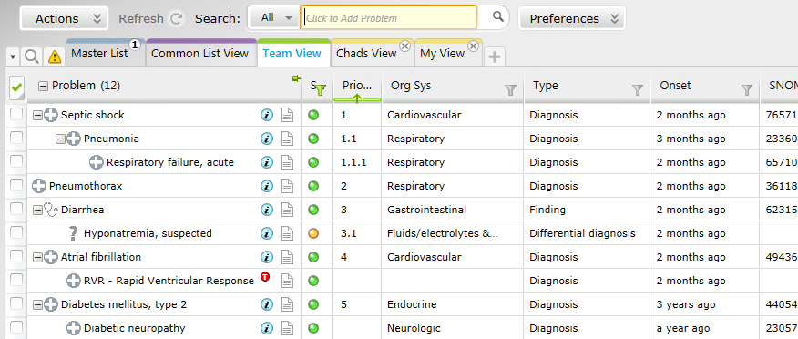
Views / Tension
Notes:
The last new feature to discuss is Views.
When testing our application, we observed some clinicians occasionally became frustrated when there were problems on the list that did not specifically pertain to the patient’s current visit.
These frustrated clinicians sometimes chose to resolve all the problems on the list and then add problems specific to the current visit, rather than deal with the existing large problem list.
This action is detrimental to the accuracy of the patient’s problem list, and may destroy years’ worth of problem history.
We termed this phenomenon Tension, because a clinician was acting as a force to deform the problem list, pushing it out of harmony with the patient’s true health state.
To resolve the underlying cause of this behavior, we created Views.
A View is simply a way for a clinician to cherry-pick problems from the large master list, and place it in a narrowly focused problem list.
This seemed to empower the clinician with a sense of ownership over the problem list, since it was filled with only those problems that he was interested in.
This empowerment is important because it can lead to a well maintained problem list.
Once in a View Clinicians were allowed to subsume problems into a hierarchy, so that they could better tell the clinical story, as well as prioritize problems.
Both the View and the subsumption features have provided entirely new types of data that may lead to interesting insight in the future about how clinicians work, and what their thought process is.

Slide 14
Results
For 5,557 patients, they added 71,838 total problems (health issues).
Free-text problems down from 11% to 1.2%
Missing attributes dropped from 27.63 per 100 problems down to 13.73 per 100.
Evolved 3,098 health issues.
Most commonly to ‘Resolve, Create History’, but nearly half of the time (1,314) a differential diagnosis was confirmed as a diagnosis.
9,352 team views were created for 5,557 patients.
Average priority added to a problem was 3
Notes:
About 13 problems were added per patient during the study period.
1.2% of problems added using the new system were free-text. Compared to 11% of free-text problems added using the legacy system during the same time period.
Half of all problems added using the Smart Search tool contained pre-coordinated information, which lowered the number of missing attributes from 27.63 per 100 problems down to 13.73 per 100 for fields such as body system, problem type, and status.
Entirely new dimensions of insight were generated using evolution. About 4% of the 72,000 problems entered (3,098) were evolved by clinicians. Mostly a problem was evolved to a historical item, but a close second occurred when clinicians added a differential diagnosis, and then confirmed it, making it a full-fledged diagnosis.
Views
1. Over 2 years, 9,352 Team Views were created for the 5,500 patients. This means that several patients were seen by more than one care team.
2. When prioritizing problems in a View, clinicians seemed to stop at about the 3rd problem,
however there was a maximum of 18 prioritized problems in a View.

Slide 15
Discussion
Large average number of problems per patient.
Clinician workflow and engagement increased.
Pre-coordinating terms helped clinicians more easily find terms.
New dimensions of data were created.
Physicians had a largely positive outlook on this new application.
Intermountain Healthcare has recently purchased Cerner.
Notes:
Clinicians added an average of 13 problems per patient using the intervention. (72,000 problems for only 5,500 patients.)
This large number of problems per patient can be explained in three ways:
Organizational incentives to meet MU coincided with use of our application, which may have inflated results.
Most of the users were in an ICU setting, and those patients have a much higher than normal number of problem.
Evolving a problem results in several new problems being created automatically, often without clinicians even being aware of that fact.

Slide 16
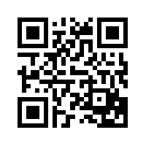
Questions?
To download the paper or presentation, scan this code
Notes:
To download the paper or presentation, scan this code
Time: 17:37

